Slide 1
UFC-Fight Historical data
Presented by:
Zafar Iqbal
Sean Staley
Yue Zhao
Vincent Hu

Slide 2
Content
Introduction to dataset
Preprocessing steps
Statistical description
Clustering
Classification
Regression

Slide 3
Ultimate Fighting Championship
The Ultimate Fighting Championship (UFC) is an American mixed martial arts promotion company based in Las Vegas.
The UFC produces events worldwide that showcase twelve weight divisions and abides by the Unified Rules of Mixed Martial Arts.
As of 2019, the UFC has held over 500 events. The UFC produces events worldwide that showcase twelve weight divisions.
The first event was held in 1993.

Slide 4
Dataset Description
UFC-Fight historical data from 1993 to 2019
This dataset contains information of all the UFC fights in the history of the organization.
Scrapped from UFCstats Website and some processing.
Made available Publically at Kaggle Machine learning Repository.

Slide 5
The dataset has:
Records: 5144
Attributes: 144
Target Variable: 1(Winner)
Missing values: 95390
Fighters are represented by 'red' and 'blue' (for red and blue corner).

Slide 6
Characteristics
Continuous value attributes: 108
Discrete value attributes: 36
Contains Binary, Ordinal, Nominal.
The target variable is ‘Winner’, which is the only column that tells you what happened. It has three unique values i.e. “Red”, “Blue” and “Draw”.

Slide 7
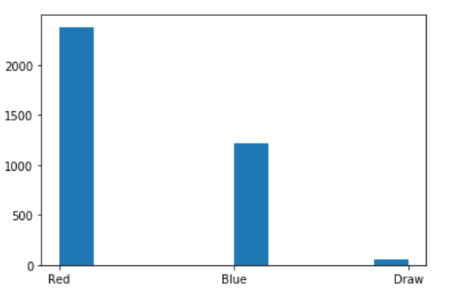
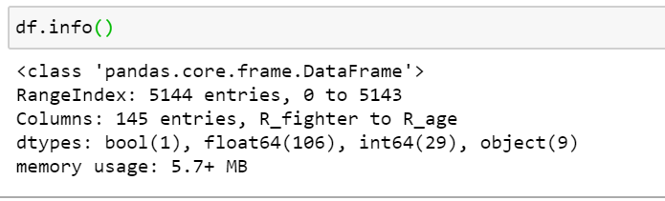

Slide 8
Some of the Attributes’ are:
Fighters’ name, Referee, Date, Height, Weight, Age, Reach, win by Knockouts, Win by majority_decision, Weight Class, title bout, Sub_Attt (number of submission attempts), Head (number of significant strikes to the head), Body etc.

Slide 9
Preprocessing
It’s a high dimensional data.
Computationally expensive
Model might over fit.
Dropped irrelevant nominal features:
Fighters’ name
Referee name
Location
Dropped Date Attribute

Slide 10
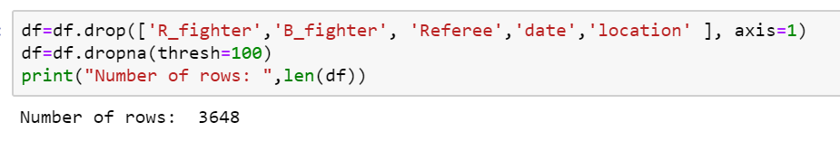
Fill-in missing values
Dropped rows containing at least 45 missing values

Slide 11
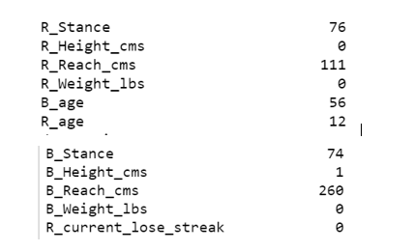

Slide 12
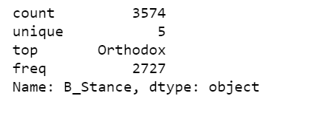
To fill in missing values in continuous value attributes (Age, Reach), we identified four highest correlated features for each of them and then applied linear regression to fill in missing values.
The remaining missing discrete value attributes were filled with most frequent value in the column.

Slide 13
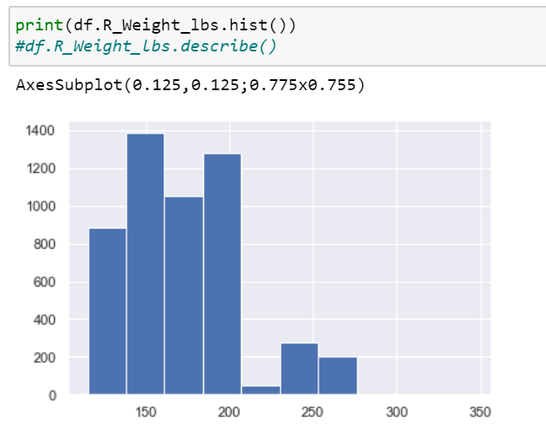
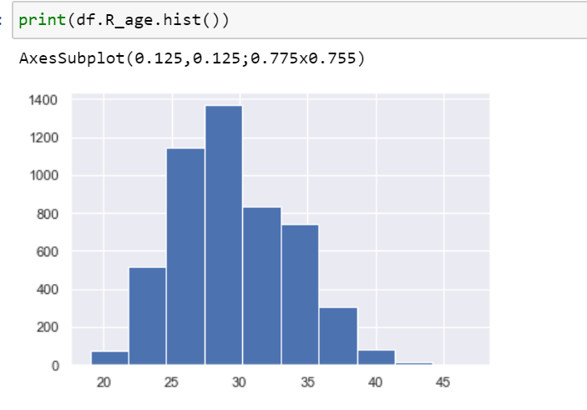
Search for Anomalies

Slide 14
Reduce dimensionality
Standardization
PCA (108 continuous values)
Grouped together 72 attributes
Correlation matrix
Dropped attributes with correlation>0.80 (24)
After PCA, we have 16 PC (85% variance)
Similar results for the remaining attributes

Slide 15
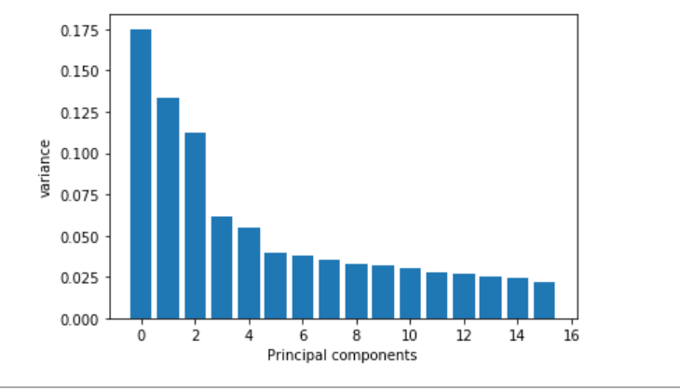
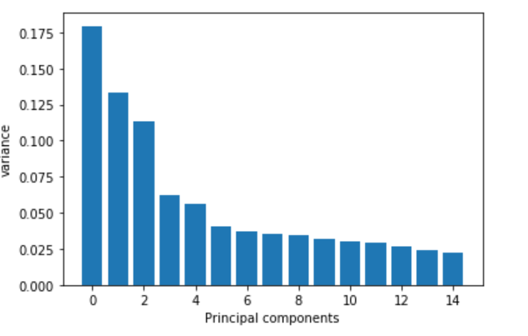
Red Vs Blue

Slide 16
Processed Data
Characteristics:
Columns: 65
Rows: 3647
Standardized values
No missing values
Low dimensional Data
No anomalies

Slide 17
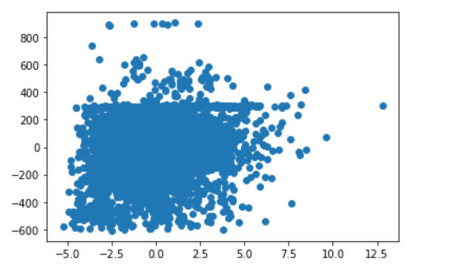
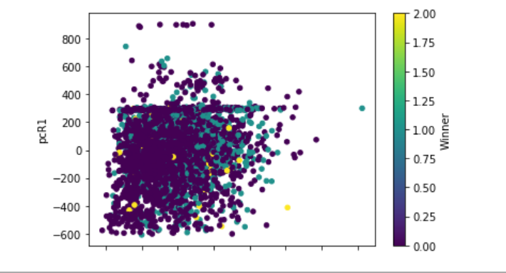
pcB1 vs pcR1

Slide 18
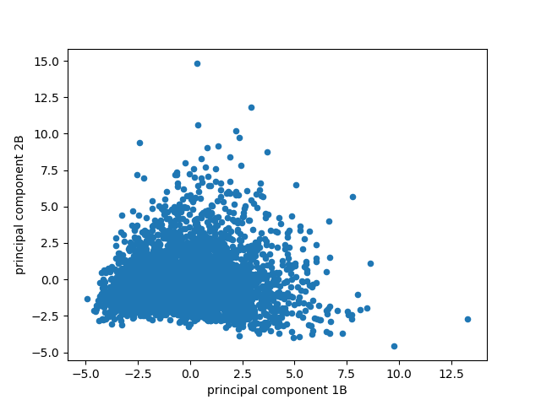
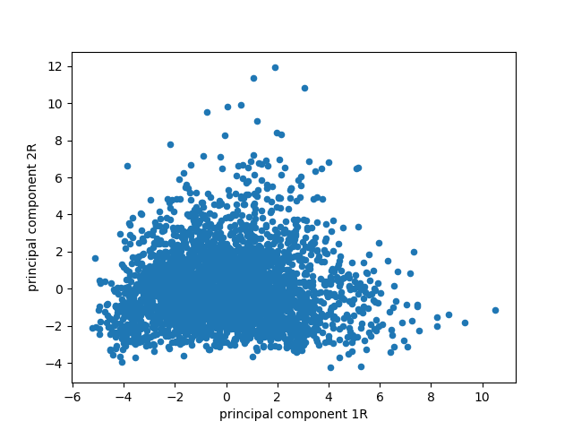
Clustering The data

Slide 19
Why Cluster?
Clusters in the data could lead to useful information such as:
Who might win a fight?
Which fighters are similar and why?
What can this fighter do different to position himself in another group of more successful fighters?

Slide 20
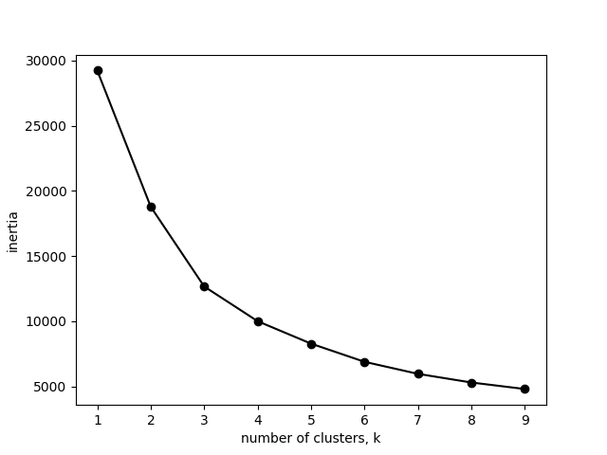

Finding the Number of Clusters
Blue Red

Slide 21
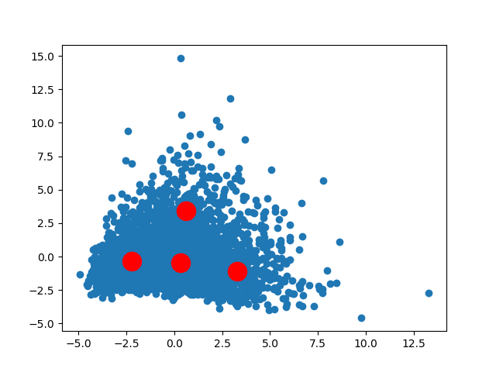
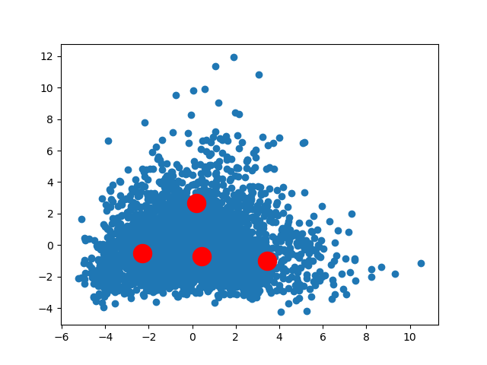
K-Means
Blue Fighter
Red Fighter

Slide 22
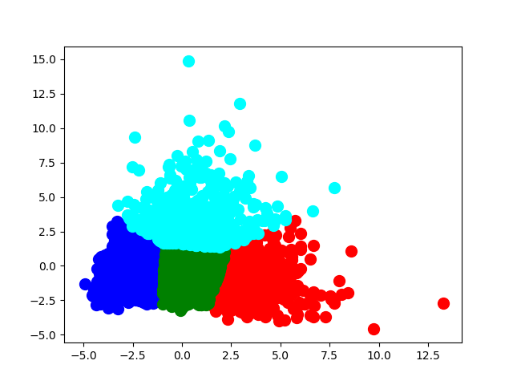
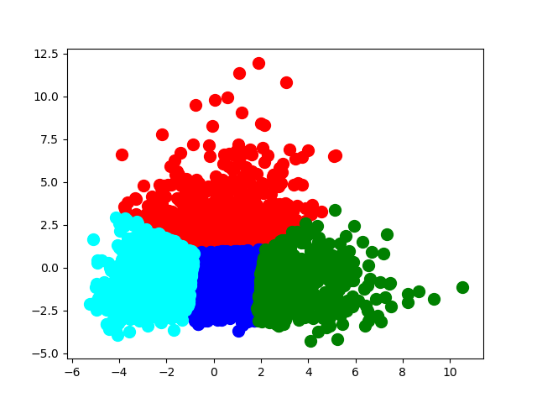
K-Means Results
Blue Clusters
Red Clusters

Slide 23
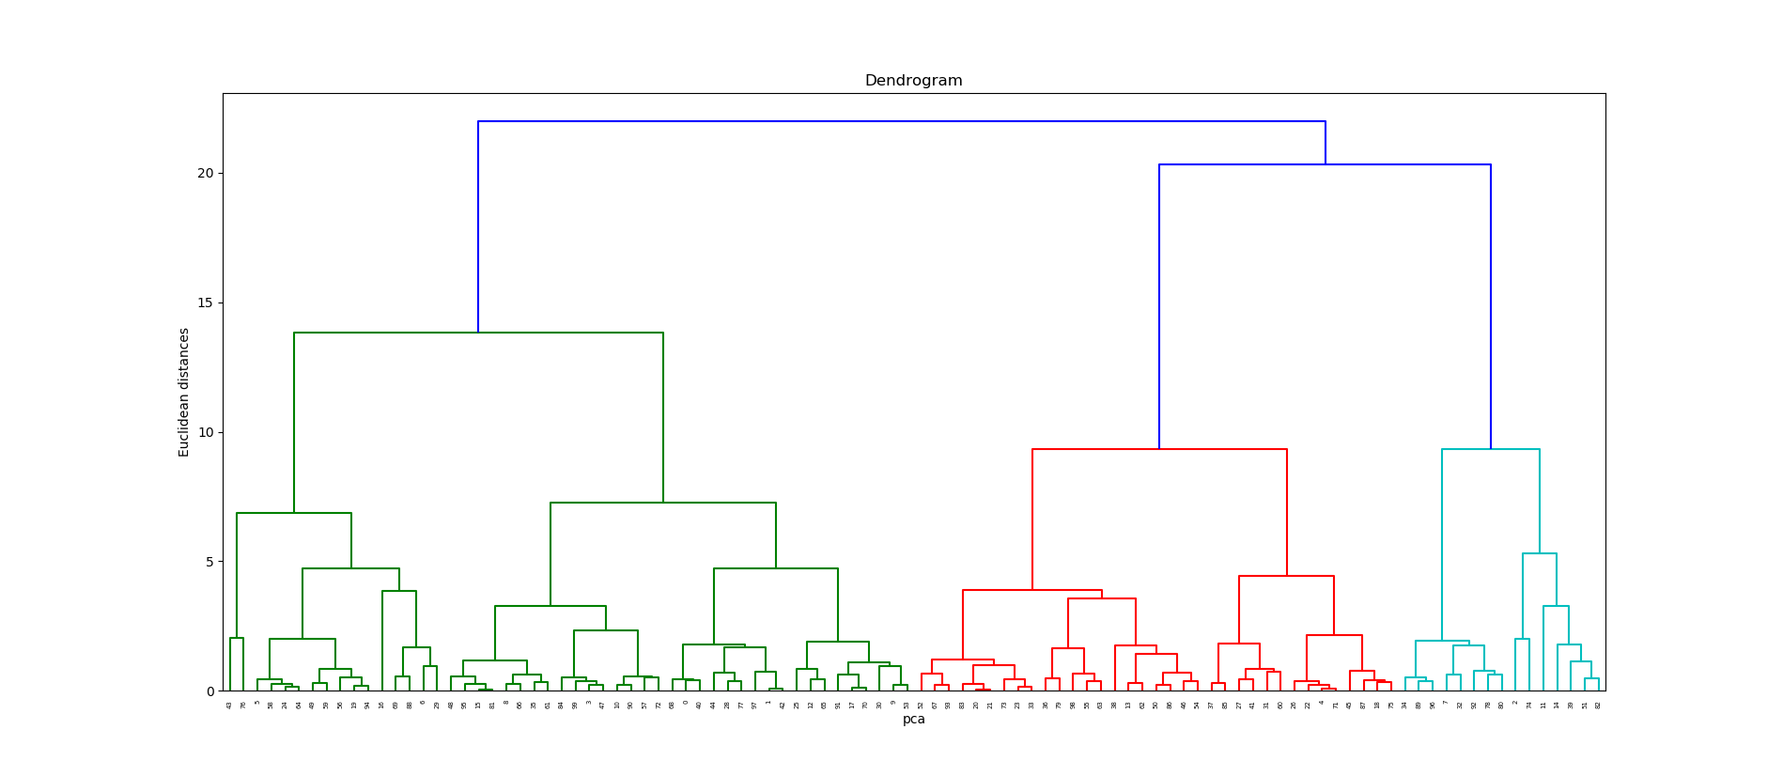
Hierarchical Clustering
Blue Dendrogram

Slide 24
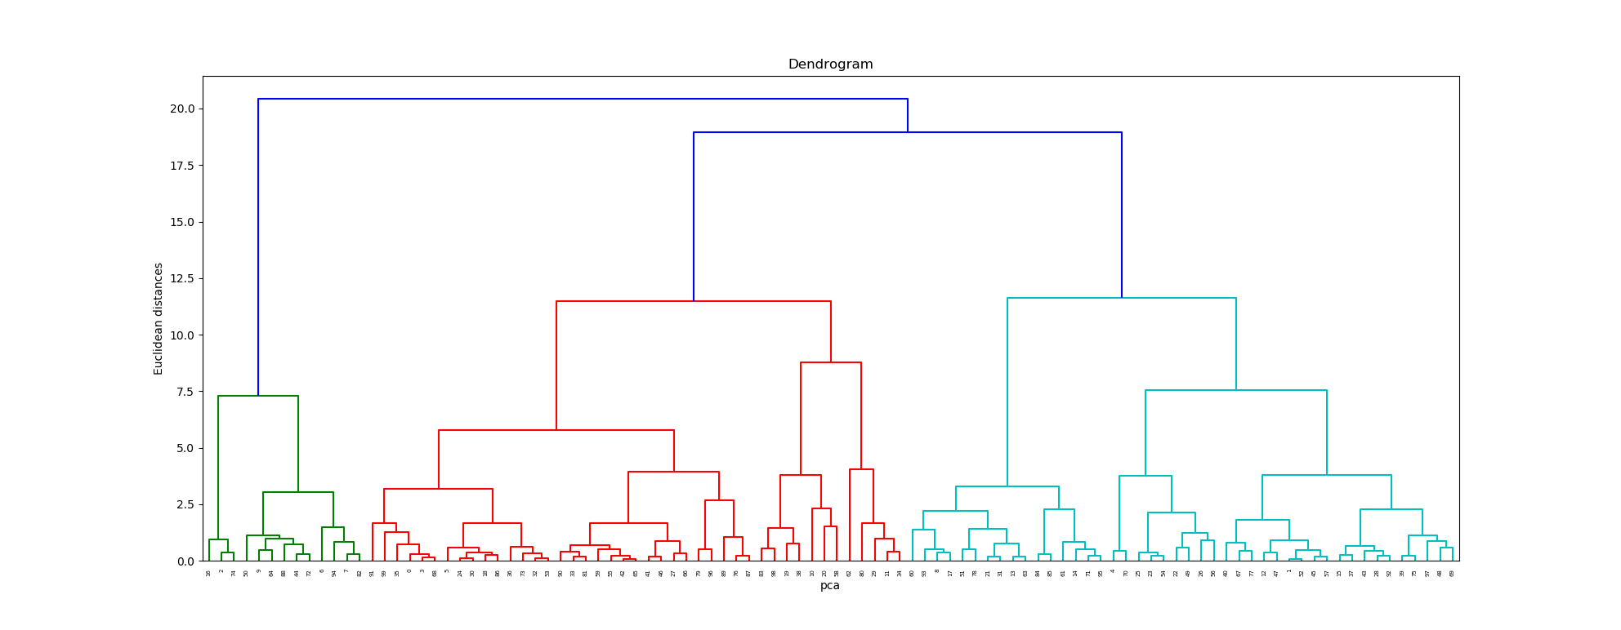
Hierarchical Clustering
Red Dendrogram

Slide 25
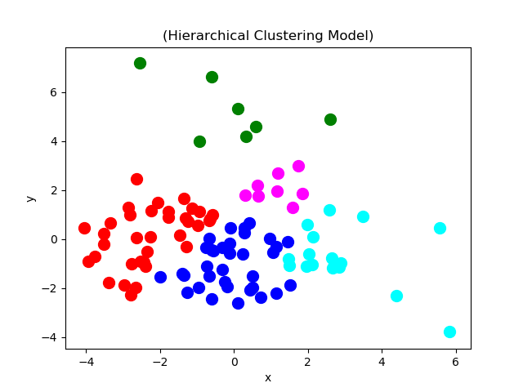
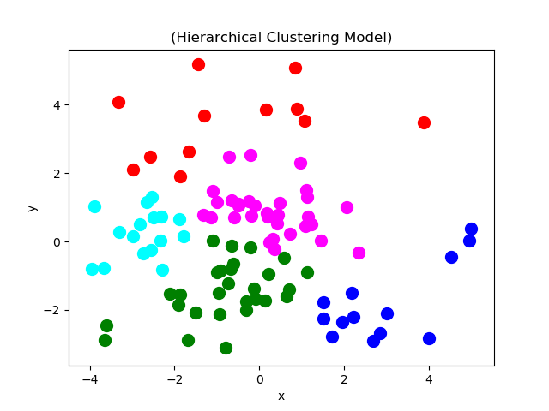
Results
Blue Fighter
Red Fighter

Slide 26
Conclusion?
This data is not well suited for clustering
The fighters are not so dissimilar from each other that one might have an advantage over the other.
A fighters stats does not necessarily mean he will win against someone with different stats.

Slide 27
Logistic Regression Assumptions
Logistic regression assumes dependent variable is binary (Win/Lose)
Logistic regression requires quite large sample sizes
The independent variables should be independent of each other
Only the meaningful variables should be included
Source: TowardsDataScience.com

Slide 28
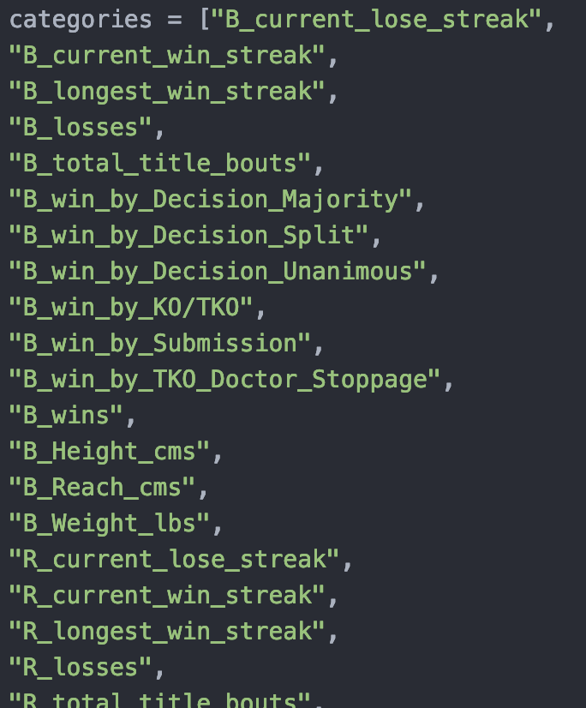
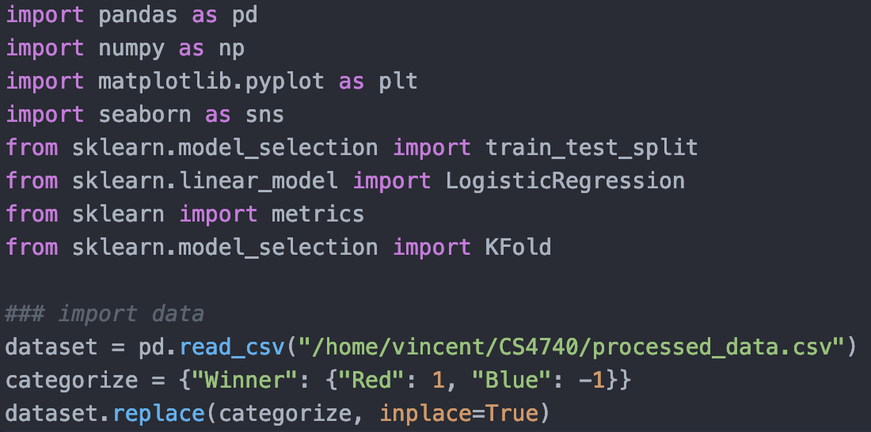
Setup

Slide 29
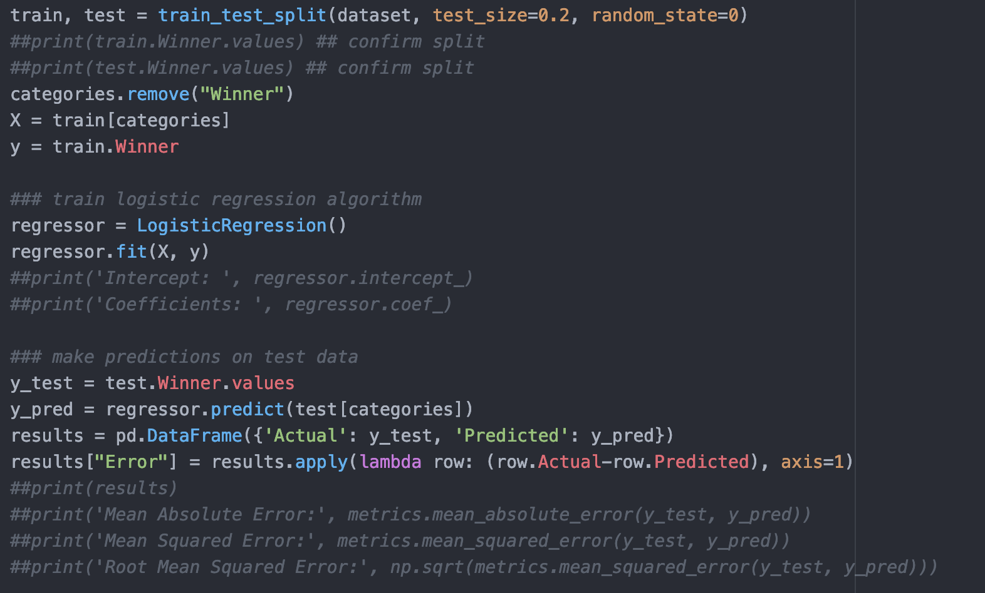
Run Logistic Regression

Slide 30
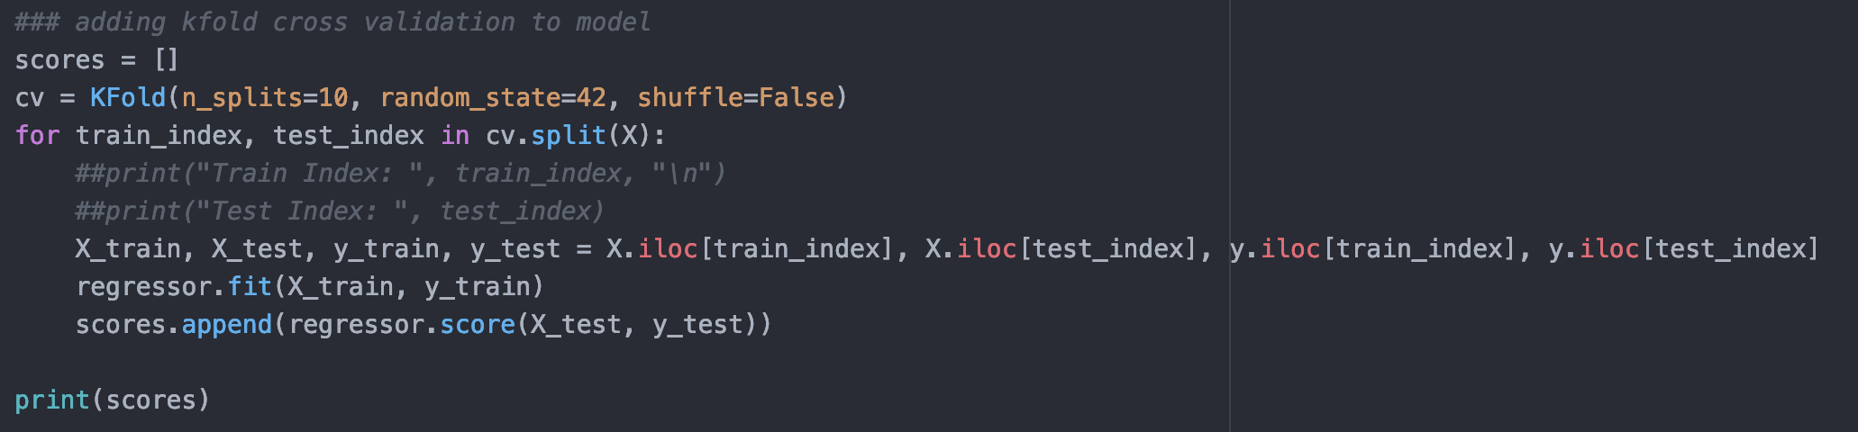
Add K-Fold Validation to Log Reg

Slide 31
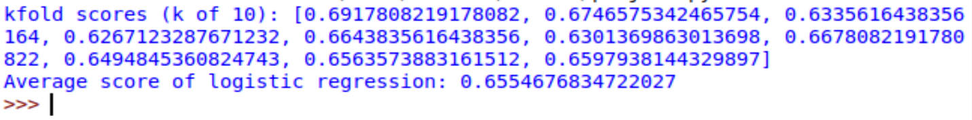
Results

Slide 32
Prediction : Random Forest
Why Random Forest?
A single decision tree tends to be prone to overfitting the training data
Random forest can average out their individual mistakes to reduce the risk of overfitting while maintaining strong prediction performance
Building Random forest is easily paralyzed across multiple CPU’s.

Slide 33
Prediction
SVM linear
SVM RBF
SVM Poly
Random Forest
Gradient Boosting Decision Tree
KNN

Slide 34
Algorithms Accuracy score
SVM linear 0.6833333333333330
SVM RBF 0.7083333333333330
SVM Sigmoid 0.6611111111111110
SVM Poly 0.7027777777777780
Random Forest 0.6944444444444440
Gradient Boosting Decision Tree 0.6944444444444440
KNN 0.6527777777777780

Slide 35
Optimize the parameters
SVM RBF
Grid search the regularization parameter C
C Accuracy score
0.1 0.7194444444444440
1 0.7083333333333330
10 0.6777777777777780
100 0.6666666666666670
1000 0.6666666666666670

Slide 36
SVM Poly
Optimize poly degree
Degree Accuracy score
0 0.7194444444444440
1 0.7194444444444440
2 0.7083333333333330
3 0.7027777777777780
4 0.7
5 0.7027777777777780
6 0.6916666666666670
7 0.7
8 0.6944444444444440

Slide 37
Gradient Boosting Decision Tree
Optimize learning rate
learning rate Accuracy score
0.05 0.7194444444444440
0.075 0.7194444444444440
0.1 0.7194444444444440
0.25 0.7138888888888890
0.5 0.7055555555555560
0.75 0.7055555555555560
1 0.6722222222222220

Slide 38
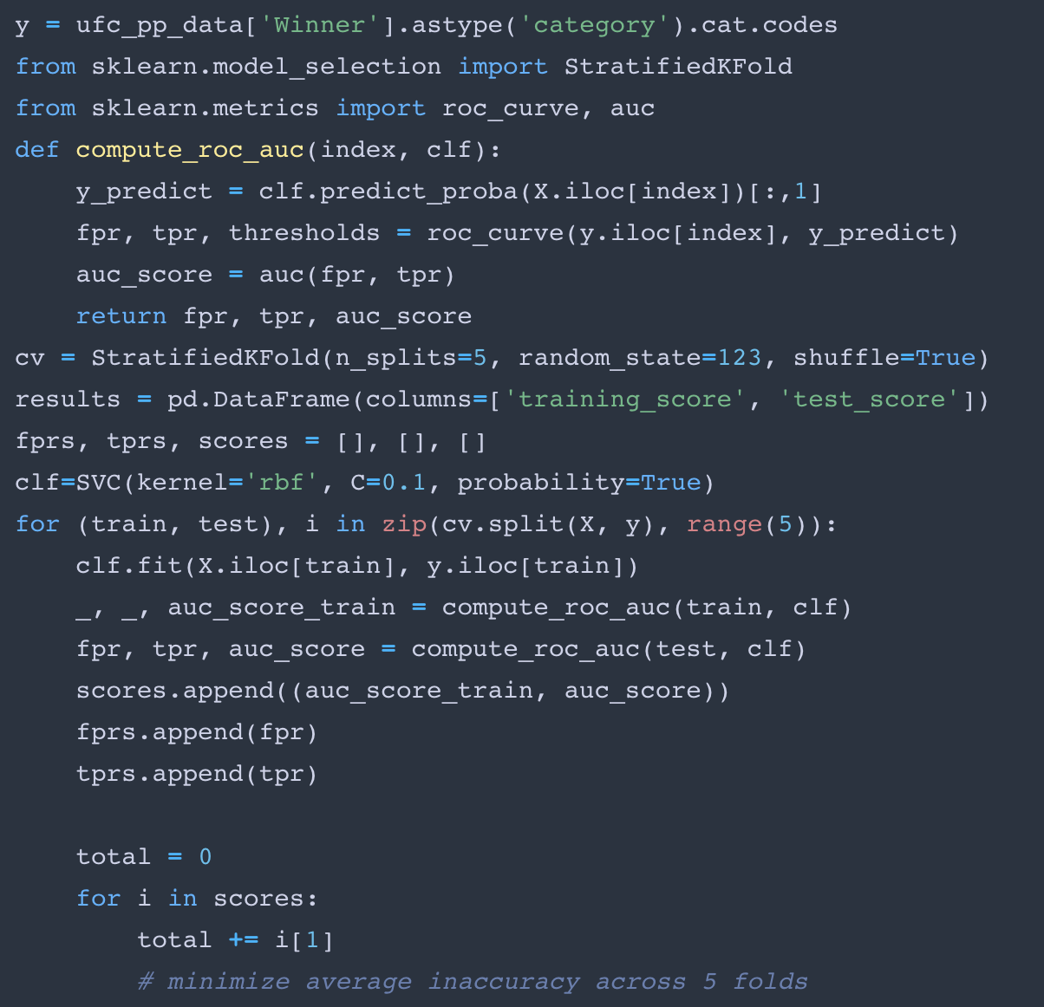
Perform k fold cross validation and Plot ROC AUC Graph
SVM RBF
Use the c regularization
parameter that yields the
best accuracy score, c=0.1

Slide 39
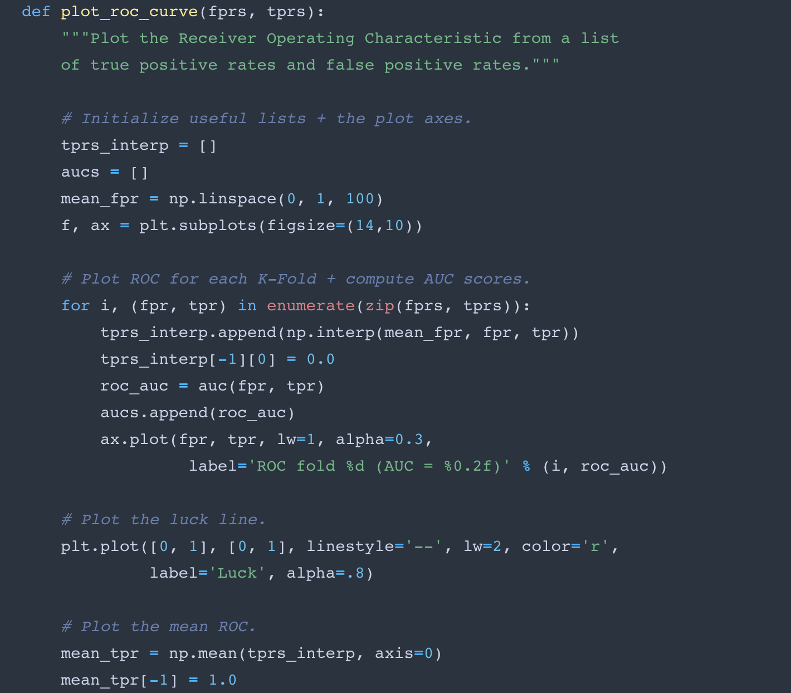
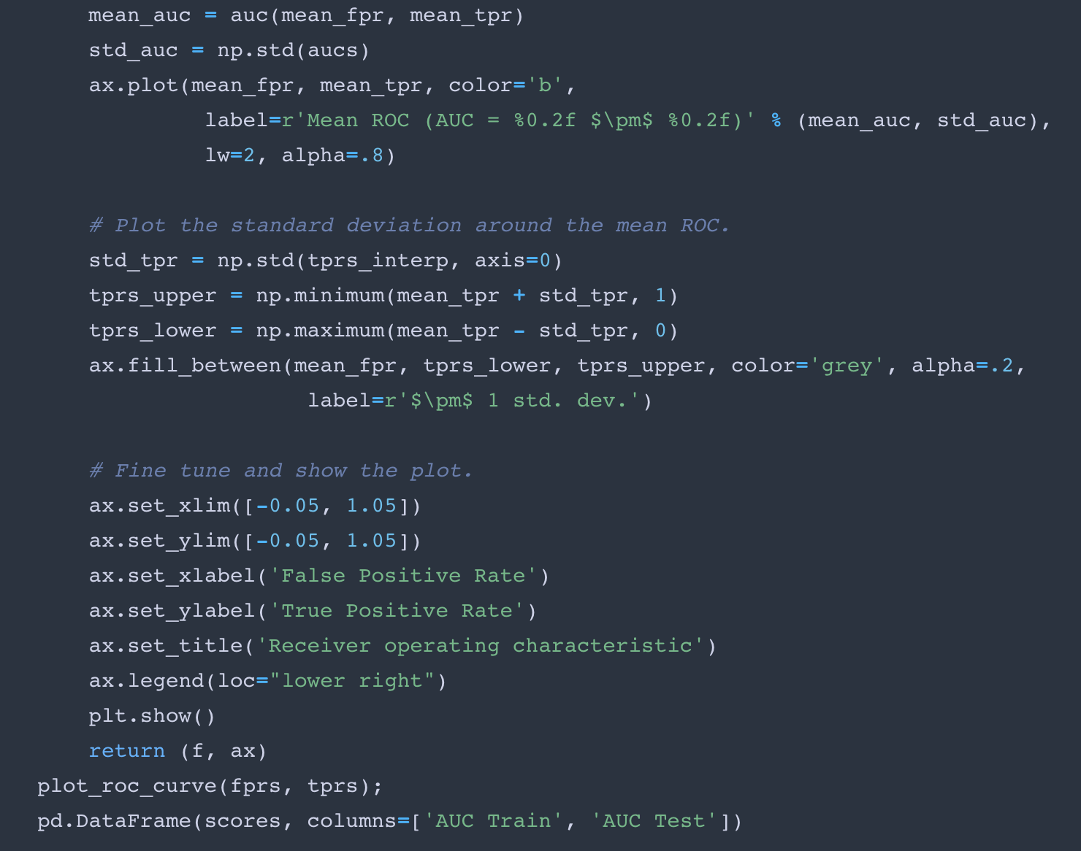
Plot ROC AUC graph

Slide 41
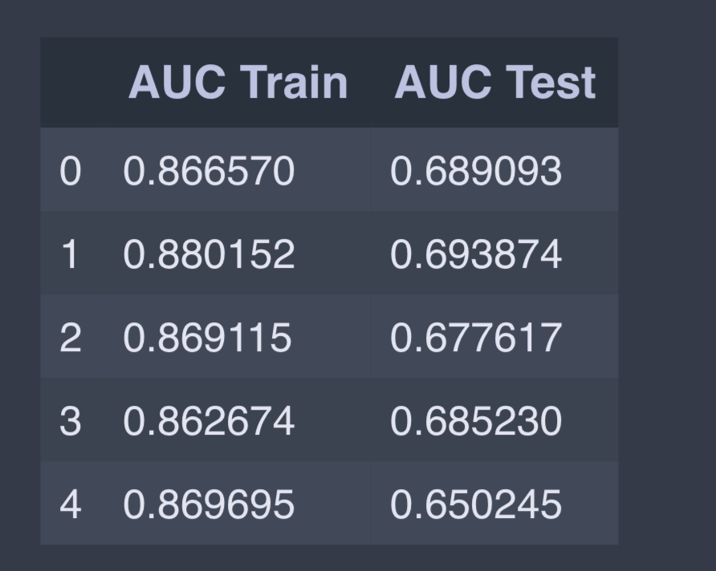
SVM RBF AUC Score

Slide 42
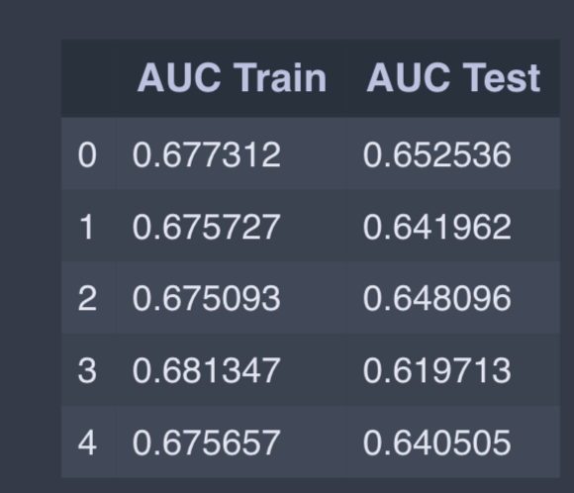
Gradient Boosting ROC AUC Curve with learning rate 0.05

Slide 43
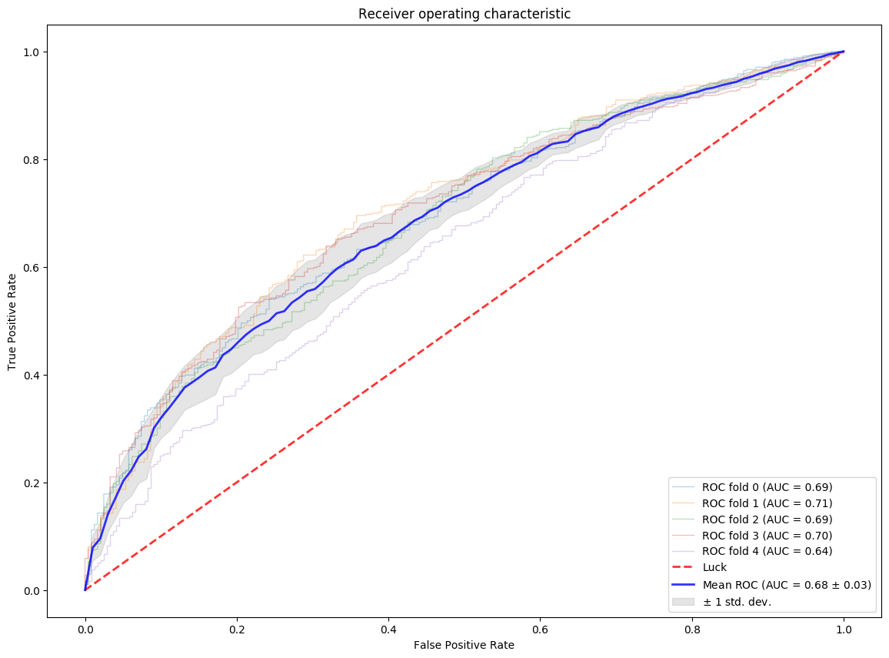
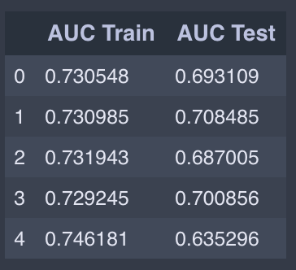
SVM Poly ROC AUC curve with degree=1

Slide 44
Optimize random forest with K fold cross validation
Used downhill simplex method to search for best parameter
space = {'params': {'estimators': hp.choice('estimators',range(50,250)),
'criterion':hp.choice('criterion',criterions),
'max_depth':hp.choice('max_depth',range(2,10)),
'min_samples_split':hp.uniform('min_samples_split',0,0.99),
'min_samples_leaf':hp.uniform('min_samples_leaf',0,0.49)}
}
best_classifier = fmin(objective_func,space,
algo=tpe.suggest,max_evals=500)

Slide 45
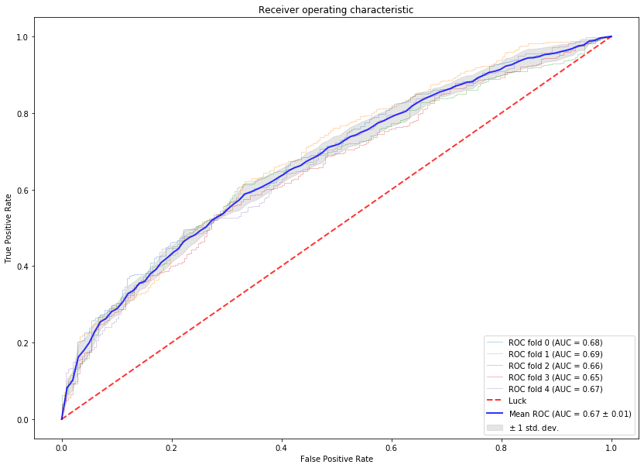

Slide 46
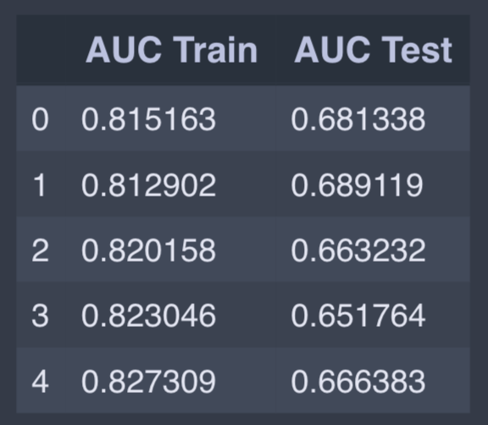
AUC is area under the curve
The bigger the area, the better the prediction. We observe that the average accuracy is about 69-70%

Slide 47
SVM RBF classifier has the best performance
clf=SVC(kernel='rbf', C=0.1, probability=True)

Slide 48
Questions??

